Slide 1
How many factors?
Methods for choosing the right number of factors in Factor Analysis
John Hinchy
Director, Data Methodology & Research
Connexity Hitwise

Slide 2
How many factors?
Agenda
Preliminaries: Introductory concepts
How many factors: Methods for choosing factors
R and Factor Analysis

Slide 3
PRELiminaries: Introductory Concepts
What Factor Analysis does; Types of Factor Analysis; Stages of Factor Analysis; R and Factor Analysis

Slide 4
Introductory concepts
Reducing the dimensionality of a data set
Often used to determine or confirm the underlying structure of a data set (latent variables, components or factors)
Based on the relations of those variables – similar variables are grouped together
Research Aim: Factor Analysis is commonly used to provide an economical description of a dataset (reduce the number of variables), or to reflect the systematic factors captured in the dataset while leaving out the stochastic element

Slide 5
Introductory concepts
Factor analysis is commonly used descriptively or as part of a test
Descriptively (Exploratory Factor Analysis – EFA) simplifies the data set, or to show the underlying structure
How many factors?
How are they related?
What do they mean?
Confirmatory Factor Analysis (CFA) tests whether a pre-determined structure adequately describes the data set
How well can the structure reproduce the original data set
Predetermined structure defined by the number of factors
The focus of this discussion is Exploratory Factor Analysis (EFA)

Slide 6
Introductory concepts
Canonical process for EFA has three steps
Test the data for factorability
Extract factors and determine optimum number
Rotate solution
Extraction is usually an iterative process with researchers trying out different extraction processes and sometimes adding in rotation as part of the testing
A key decision in Factor Analysis is the number of factors
A key outcome of the analysis, which can determine whether the solution is ‘right’
The choice of factor numbers affects the subsequent rotation step

Slide 7
Introductory concepts
Why R and Factor Analysis? (particularly the number of factors)
Although determining the number of factors may be the most important step in EFA, methods in practice have not progressed as much as they could have.
R users, as progressive researchers should be aware of the methods and their limitations
R provides access to a full range of methods for choosing the number of factors, whereas some other statistical packages offer less freedom

Slide 8
Methods for choosing factors
Different methods ‘recommend’ different numbers of factors. What are the common methods and how do they differ?

Slide 9
Methods for choosing factors
Choosing the right number of factors balances representivity of the data (more factors) with parsimony or economy of the description (fewer factors)
There are many methods:
Traditionally dominated by 2-3 methods
Divide between Post Hoc and A Priori
Post Hoc: The ‘right number’ is based mainly on the data
A Priori: The ‘right number’ fits an expectation related to the research
Focus for this presentation is Post Hoc, although in practice, a priori considerations usually play a role

Slide 10
Methods for choosing factors
Post Hoc Methods
Compare features of the factors against a criterion. The most commonly used methods have become ‘old saws’ that are (often) accepted uncritically.
Pros: Most of these methods are very widely supported by software applications. Their broad adoption makes comparisons between results easier … perhaps.
Cons: They are often demonstrated to give incorrect results. They fail to take account of the purpose of the analysis
Eigenvalue > 1 (Kaiser’s criterion)
Scree Plot
Total Variance Explained
MAP test
Parallel Analysis (PA)
This is not an exhaustive list of factor selection methods. They are the more common methods.

Slide 11
Methods for choosing factors
Eigenvalue > 1 (K1, Kaiser’s criterion)
Method: Count (unrotated) factors with eigenvalues greater than 1.0
Rationale: Choose components (factors) that explain more variance than the average, single variable
Pros: Universally supported in applications and very easy to use. Intuitively appealing – easy to understand
Cons: Often extracts too many factors (generally one-third to one-fifth of the variables). Because it’s insensitive to the purpose of the analysis, some small factors (<1) that are theoretically important can be missed.
Factor | Eigenvalue | % Var | % Cum.Var.
1 | 2.880437 | 32.0% | 32.0%
2 | 1.438654 | 16.0% | 48.0%
3 | 1.16393 | 12.9% | 60.9%
4 | 1.024453 | 11.4% | 72.3%
5 | 0.705209 | 7.8% | 80.1%
6 | 0.647623 | 7.2% | 87.3%
7 | 0.562393 | 6.2% | 93.6%
8 | 0.345248 | 3.8% | 97.4%
9 | 0.232053 | 2.6% | 100.0%

Slide 12
Methods for choosing factors
Scree test (Cattell)
Method: Plot the Eigenvalues of factors and cut off at the inflexion point
Rationale: Heuristic ‘based on experience’(?) Separating important from trivial factors. Stop when any further factors do not add much more explanatory power
Pros: Almost universally supported in applications and very easy to use. The visual methodology makes it appealing to apply. Said to be more independent of number of variables
Cons: Determining where is the inflexion point is subjective and often vague. It often identifies too many factors. It is also less clear with smaller samples and when variables:factor ratio is low.

Slide 13
Methods for choosing factors
Total Variance Explained
Method: Select factors that together explain up to criterion level of total variance. The criterion is often 80-90%
Rationale: Factors that explain the majority of the variance, favouring the factors that explain the most variance
Pros: Almost universally supported in applications and easy to use. Easy to explain and intuitively appealing
Cons: There is no specific rationale for a particular criterion (80%, 90%, …) and therefore the value chosen is generally subjective. Often returns a large number of factors, particularly with ‘noisy’ data
Factor | Eigenvalue | % Var | % Cum.Var.
1 | 2.880437 | 32.0% | 32.0%
2 | 1.438654 | 16.0% | 48.0%
3 | 1.16393 | 12.9% | 60.9%
4 | 1.024453 | 11.4% | 72.3%
5 | 0.705209 | 7.8% | 80.1%
6 | 0.647623 | 7.2% | 87.3%
7 | 0.562393 | 6.2% | 93.6%
8 | 0.345248 | 3.8% | 97.4%
9 | 0.232053 | 2.6% | 100.0%

Slide 14
Methods for choosing factors
Minimum Average Partial (MAP; Velicer)
Method: Compare the average of the squared correlations among variables having partialed out 1, 2, … factors. The optimum number of factors corresponds with the minimum average correlation
Rationale: Retain factors until all non-random variance has been explained
Pros: Empirically demonstrated to be more accurate than older methods
Cons: Less widely known or used (though getting better). Not widely implemented in statistical packages (until recently). Tends to underestimate number of factors, particularly if few variables per factor or low averaging loadings

Slide 15
Methods for choosing factors
Parallel Analysis (PA; Horn)
Method: Generate random datasets replicating the number and size of test data set. Choose eigenvalues of test data set that are larger than mean eigenvalues over the random sets. More recent criterion is test against 95th percentile of randomly generated eigenvalues
Rationale: Factors that explain more than would be expected on an uncorrelated (non-structural) equivalent set.
Pros: Intuitively appealing as a type of K1 test that takes account of the details of the current data set. Empirically demonstrated to be more accurate than other methods
Cons: Not widely known or used (though getting better). Not widely implemented in statistical packages (until recently) and computationally demanding.

Slide 16
R and Factor Analysis
What are the common packages available in R and what do they offer?

Slide 17
R AND Factor Analysis
R natively supports Principal Components and Factor Analysis (MLE).
Princomp reports results of principle components as measures of variance explained (standard deviations) that can be used to perform K1, or through screeplot to prepare the scree plot. Cumulative variances are also presented
Factanal reports ML analysis allowing the number of factors to be specified. Measures of variance explained are presented and can be used for K1, plotted for the scree test or assessed against the cumulative variance explained criterion
Neither of these support PA or MAP techniques (without further adaptation

Slide 18
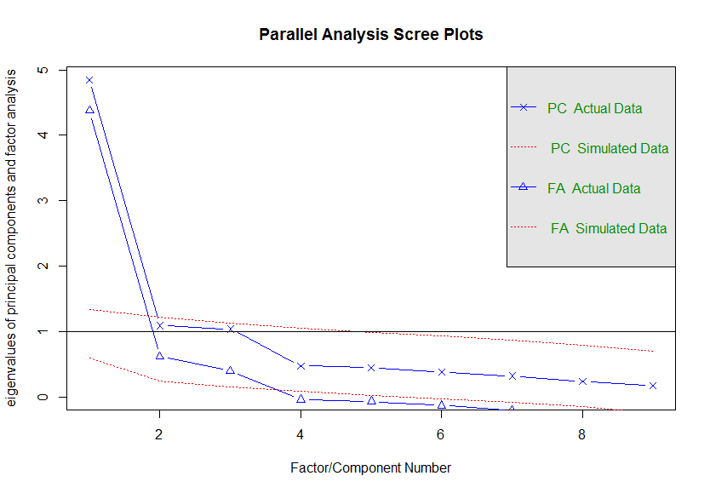
R AND Factor Analysis
R library ‘psych’ supports range of different extraction techniques and supports a wide range of factor retention methods
K1, Scree plot, Cumulative variance
MAP
Parallel Analysis (PA)
VSS (Very simple structure), which compares the original correlation matrix against a reproduced matrix based on a limited number of factors
Parallel analysis invoked by ‘fa.parallel’ and recommends number of factors and components as well as chart to illustrate the results.
Parallel analysis: Minimal specification
fa.parallel(x, n.obs)
x: data input, either raw data or a correlation matrix
n.obs: number of observations used for the corr. matrix

Slide 19
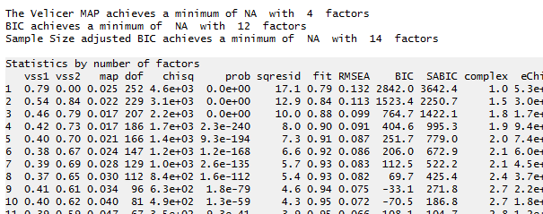
R AND Factor Analysis
MAP is invoked by ‘vss’, and is included by default as part of the test results
vss provides output to compare various other criteria including the author’s ‘Very Simple Structure’
MAP analysis: Minimal specification
vss(x, n)
x: data input, either raw data or a correlation matrix
n: number of observations used for the corr. matrix

